Slide 1
Day 4 – Model Driven Apps

Slide 2
Content
Dataverse Security
Security Structure in Dataverse
Business Units
Teams and types of teams
Users and Security Roles
Field Level Security and Hierarchy Security
Working with Solutions (Managed/Unmanaged)
Working with tables
Types of Tables
Activity and Virtual Tables/ Entities
Q&A

Slide 3
Dataverse Security
Users are authenticated by Azure Active Directory (Azure AD).
Licensing is the first control-gate
Ability to create applications and flows is controlled by security roles in the context of environments.
Sharing of canvas apps is done directly with a user or Azure AD group but is still subject to Dataverse security roles.
Sharing of model-driven apps is done via Dataverse security roles.
Environments act as security boundaries allowing different security needs to be implemented in each environment.
Flows and Canvas apps use connectors, the specific connections credentials and associated service entitlements determine permissions when apps use the connectors.

Slide 4
Security Model
Business Units
Users
Teams
Security Roles
Field Security Roles
Hierarchy Security
Access Team Templates

Slide 5
Business Units
Business Units
There are business units. Those are logical partitions where you can put users, teams, and child business units
There is one root business unit in each environment – it does not have a parent BU. Other than the “root”, there can be any number of child business units (each of the “child” business units has to have a “parent”)
Every business unit can have multiple teams. Every team can belong to only one business unit. There is a single default team per business unit. Users can be added to teams (teams cannot be added to other teams)

Slide 6
Teams
Teams
Teams are owned by a Business Unit. Every Business Unit has one default team that is automatically created when the Business Unit is created.
The default team members are managed by Dataverse and always contain all users associated with that Business Unit.
You can’t manually add or remove members from the default team
There are two types of teams
Owning Teams - Can own records, which give any team member direct access to that record. Users can be members of multiple teams.
Access Teams - The teams are dynamically formed and dissolved. This typically happens if the clear criteria for defining the teams, such as established territory, product, or volume aren’t provided.
You need to use Access Team teamplate to form access teams

Slide 7
Users and Security Roles
Users
Every user in the specific dataverse environment has to belong to one and only one business unit
Security Roles
There are some pre-defined security roles in Dataverse which are listed below and we can also create custom security roles and provide different permissions
Environment Maker
System Administrator
System Customizer
Basic User
Service Reader
Service Writer
Delegate
Support User
Office Collaborator

Slide 8
Field and Hierarchy Security
Field/Column Security
You use field security tables to apply field-level security, which restricts field access to specified users and teams.
The scope of field-level security is global, which means that it applies to all records within the organization, regardless of the business unit hierarchical level to which the record or the user belongs.
You can configure Read/Write/Update permission user wise
You can use Field Security Profiles to configure the permissions
Hierarchy Security
You can define and setup different levels of hierarchy from your business/organization and define access permission user/team wise
You need to enable Hierarchy modeling before using it
You can either selected predefined hierarchy template or can configure custom hierarchy
Hierarchy depth specifies number of levels

Slide 9
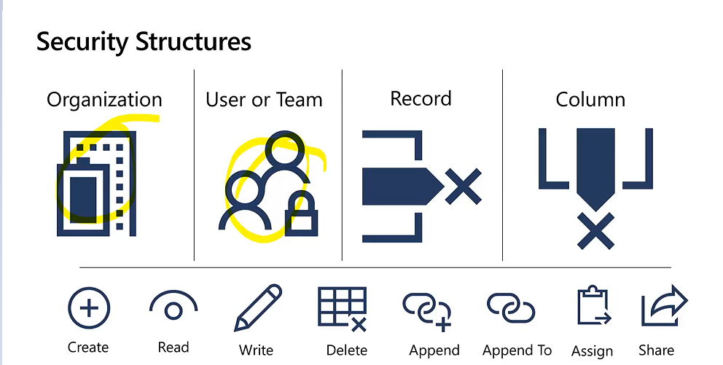

Slide 10
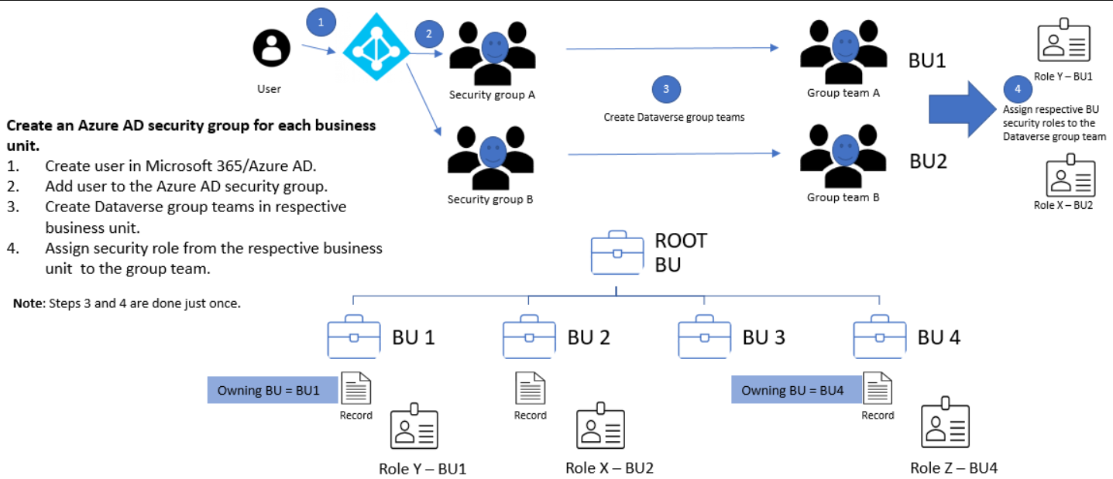

Slide 11
Solutions
Default Solution
The system solution contains the out-of-the-box solution components defined within Microsoft Dynamics CRM without any customizations.
Many of the components in the system solution are customizable and can be used in managed solutions or unmanaged customizations.
You cannot export default solution
Managed Solution
A managed solution is a solution that is completed and intended to be distributed and installed. Managed solutions can be installed on the top of the system solution or other managed solutions
If you export a managed solution from one organization and import it to another, you can’t edit the solution in the new organization.
Uninstalling a managed solution uninstalls all the customizations associated with the solution
By default, a managed solution can’t be customized in the target organization. However, using the concept of managed properties you can define whether a solution component will be customizable

Slide 12
Solutions
(Continued)
Unmanaged Solution
An unmanaged solution is a solution that is still under development and not intended to be distributed.
By default, any new solution is an unmanaged solution. However, you can export an unmanaged solution as a managed or unmanaged solution.
If you export an unmanaged solution from one organization and import it to another, you can edit the solution in the new organization.
An unmanaged solution directly references the system solution. Hence, the changes made to one unmanaged solution will be applied to all the unmanaged solutions that references the same components, including the system solution
If you delete a solution component from an unmanaged solution, the component gets deleted permanently from the system and will no longer be available. In case you just want to remove the component from specific unmanaged solution, use remove instead of delete.
Uninstalling an unmanaged solution does not remove the associated customizations. It just deletes the solution from the system, but the changes you made will still be there.

Slide 13
Tables
Tables are used to model and manage business data. When you develop an app, you can use standard tables, custom tables, or both.
Below are the types of tables
Standard Tables
Also known as out-of-box tables. Account, business unit, contact, task, and user etc. are the standard tables
Managed Tables
Managed tables that aren’t customizable and have been imported into the environment as part of a managed solution
Custom Tables
Custom tables are unmanaged tables that are either imported from an unmanaged solution or are new tables created directly in the environment. Any user with appropriate privileges can fully customize these tables

Slide 14
Activity and Virtual Tables
Activity Tables
Activity tables are a special kind of table that can only be owned by a user or team but can’t be owned by an organization.
When you create a table, you can specify it as a standard or activity table.
E.g. Appointment, Email, Fax, Phone call, Task, Letter etc.
Virtual Tables
A virtual table is a custom table in Dataverse that has columns containing data from an external data source.
Virtual tables appear in your app to users as regular table rows, but contain data that is sourced from an external database dynamically at runtime, such as an Azure SQL Database.
Rows based on virtual tables are available in all clients including custom clients developed using the Dataverse web services

Slide 15
Thank You

